Slide 1


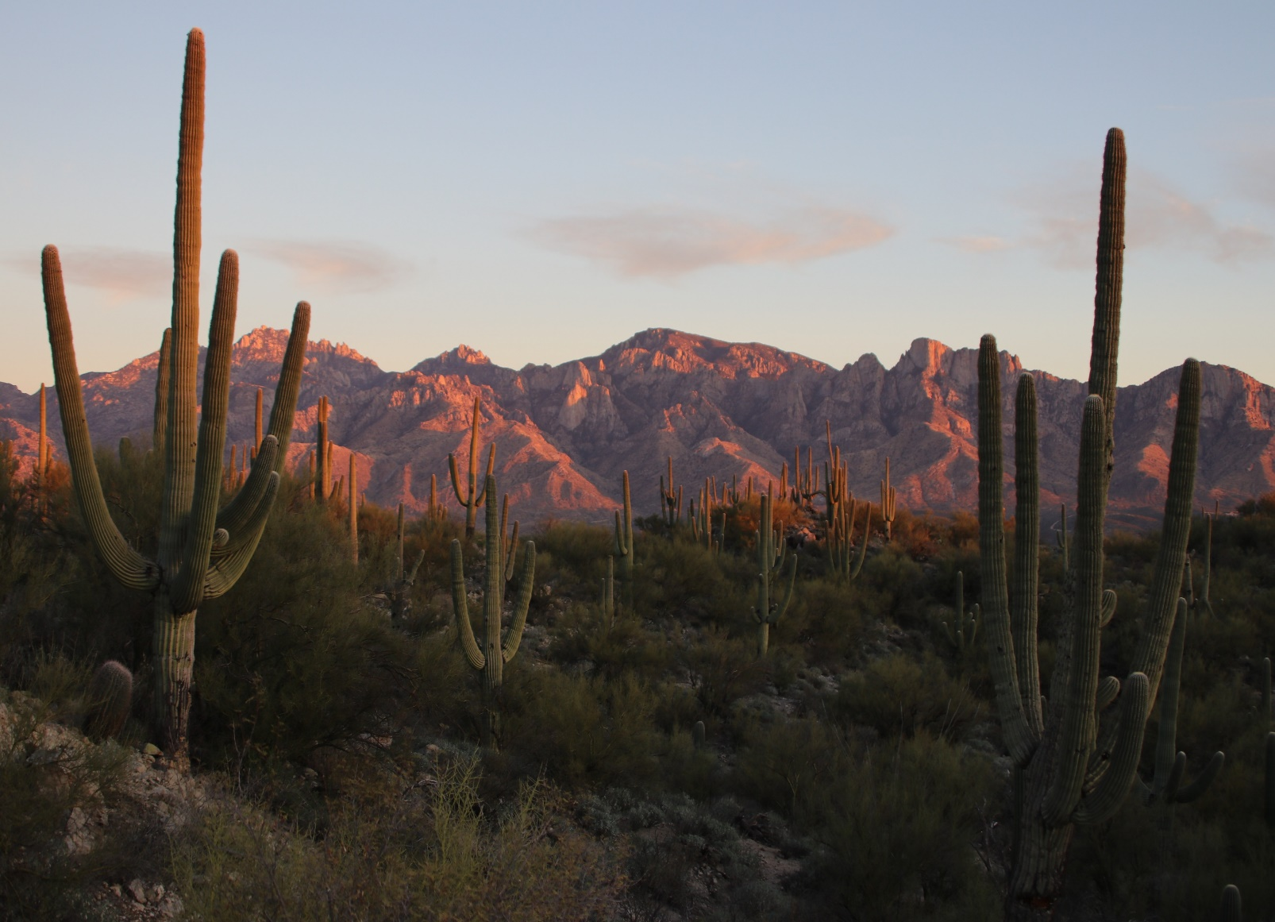
Master Homeowners Association
Welcome Packet

Slide 2


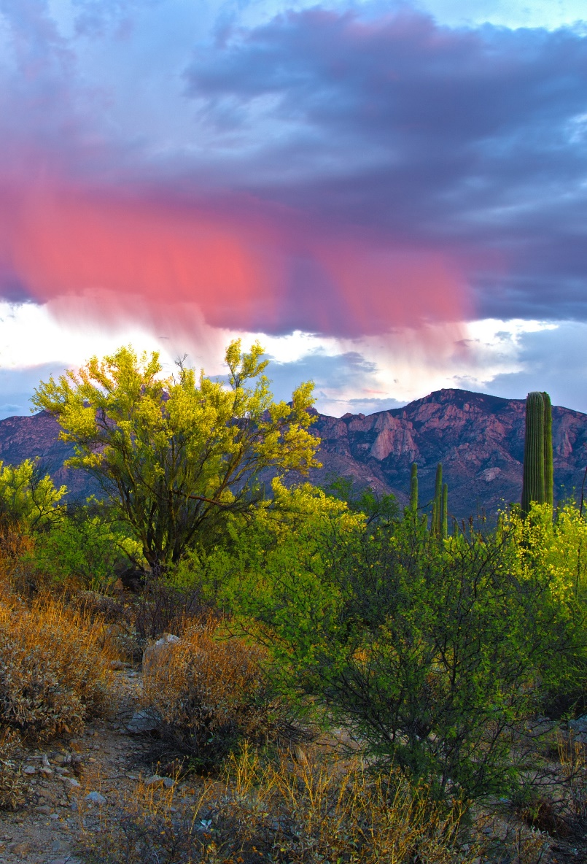

Welcome to Rancho Vistoso
https://ranchovistosohoa.com/
2

Slide 3

Contents
Welcome to Rancho Vistoso 4-5
4-5
Community Contacts 6
School District 7
VCA Management Team 8
Board of Directors 9
Assessments 10
Payment Options 11
E-Statements 12-15
Parks & Trail Map 16
Park Amenities 17
Communications 18
Compliance Reminders 19
Architectural & Landscaping Review 20-21
FAQ 22
Welcome to Rancho Vistoso
https://ranchovistosohoa.com/
3

Slide 4


Welcome to the neighborhood
On behalf of the community, welcome home to Rancho Vistoso.
Hearing the words “homeowners association” can be off-putting. Rest assured — this association and this community are unique. The Vistoso Community Association, often referred to as Rancho Vistoso is a master-planned 7,626-acre community located in Oro Valley, Arizona where the lifestyle is remarkable, and the views are exceptional. It is located 20 miles north of downtown Tucson, nestled between Tucson’s Santa Catalina and Tortolita Mountains. Rancho Vistoso is comprised of 28 neighborhoods and 28 sub-associations, all of which offer the residents many outdoor recreational facilities along with shopping, dining, and entertainment options.
Welcome to Rancho Vistoso
https://ranchovistosohoa.com/
4

Slide 5
Information regarding upcoming events will be published in the newsletter on the website at
www.ranchovistosohoa.com
The website is an excellent source of information. Please take a moment to create a user login. If you need answers to questions, please contact the management staff, as they are happy to assist you and be your resource for navigating the community.
Sincerely,
Vistoso Community Association Management Team
(520) 354-2729
askVCA@ranchovistosohoa.com
There are eleven parks residents can access in Rancho Vistoso, which feature playgrounds, sports courts, dog parks, ramadas, hiking, biking trails, and ample greenspace. For golfers living in Rancho Vistoso, there are several championship golf courses in the area as well as practice facilities. There are several public schools in the Amphitheater Unified School District that parents and students have access to nearby: Innovation Academy, Painted Sky Elementary School, Coronado Middle School, and Ironwood Ridge High School. For higher education, residents have access to Pima County Community College or the University of Arizona.
Overall, Rancho Vistoso has a tasteful balance of residential, commercial, office, and recreation use to create an aesthetically pleasing living environment. It promotes reasonable high standards of development, landscaping design, and architectural guidelines for the benefit of the existing and future residents.
The Vistoso Community Association Board of Directors is elected by the members of the community. As per the governing documents, your board comprises of seven members: five single-family, one other than single-family, and one commercial representative.
The Board is responsible for maintaining the common areas and amenities of the community, preparing and adopting the annual budget, setting and collecting assessments, establishing rules and regulations, enforcing the governing documents, keep a detailed accounting of members and accounts.
The Vistoso Community Association Board of Directors has partnered with FirstService Residential to manage the daily operations of your community. You have four dedicated on-site employees at the VCA office located at 1171 E Rancho Vistoso Blvd, Suite 103. You can also contact the association at 520-354-2729 or email askvca@ranchovistosohoa.com.
Welcome to Rancho Vistoso
https://ranchovistosohoa.com/
5

Slide 6
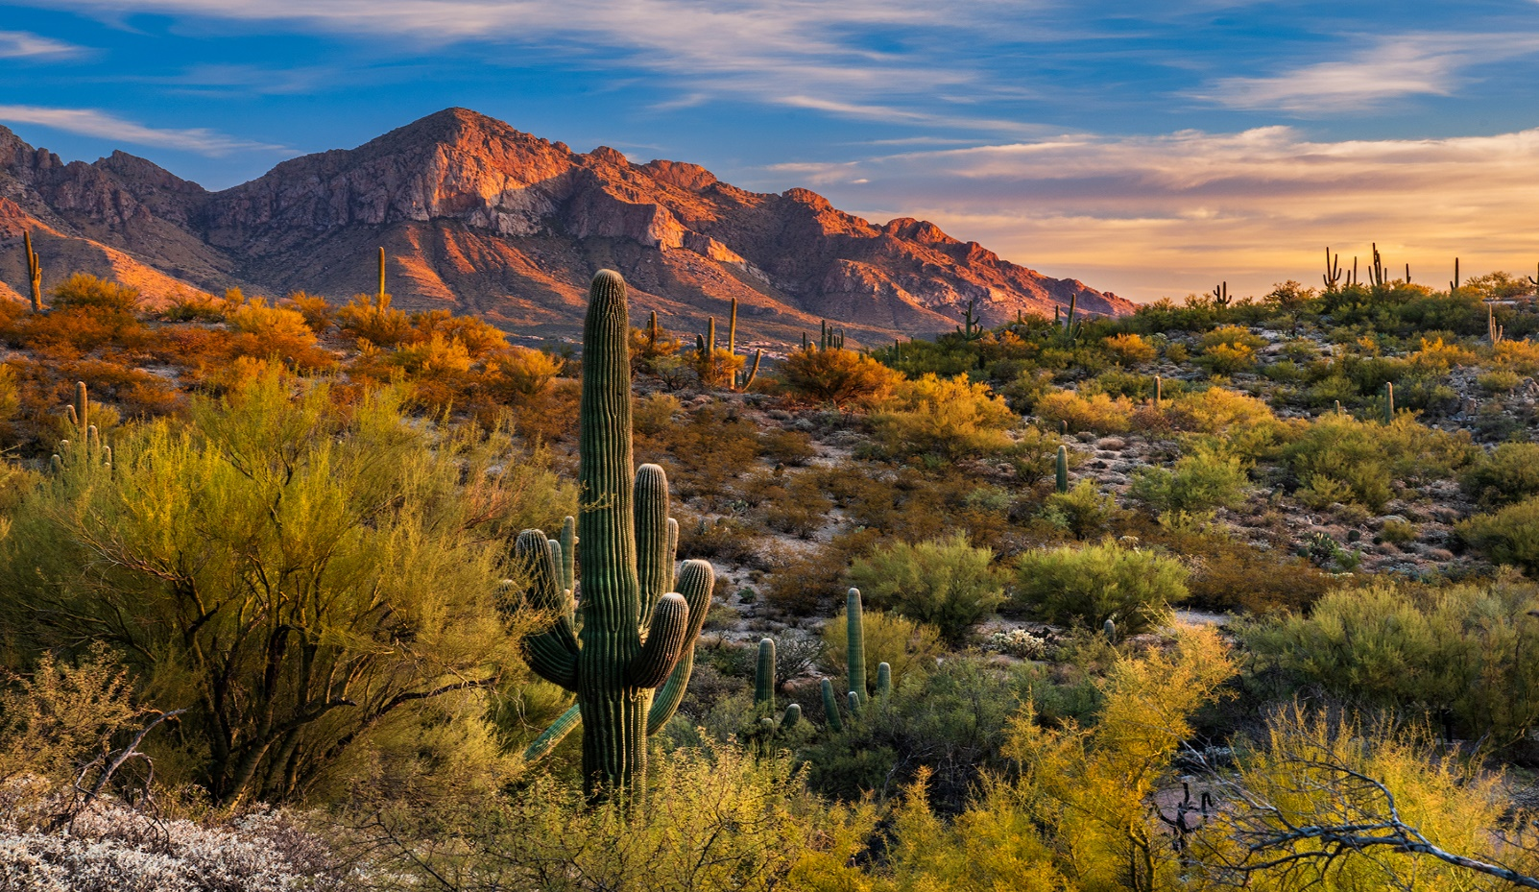
Community Contacts
Service & Utilities
4-5
POWER
Tucson Electric Power Address: 88 E Broadway Blvd, Tucson, AZ 85701 Phone: (520) 623-7711
WATER
Oro Valley Water Address: 11000 N LaCañada Dr, Oro Valley, AZ 85755
Phone: (520) 229-5000
GAS
Southwest Gas Address: 3401 E Gas Rd, Tucson, AZ 85714
Phone: (877) 860-6020
Cable, Phone, & Internet
INTERNET
CenturyLink
Phone: (855) 514-3607
SATELLITE
Direct TV
Phone: (866) 631-1261
CABLE
Xfinity
Phone: (800) 934-6489
Non - Emergency Postal
POLICE
Oro Valley Police Department
Phone: (520) 229-4900
FIRE DEPARTMENT
Golder Ranch Fire Department
Phone: (520) 825-9001
POST OFFICE
Tucson Electric Power 11900 N LaCañada Dr, Oro Valley, AZ 85755
Phone: (800) 275-8777
For all emergencies dial 911
Welcome to Rancho Vistoso
https://ranchovistosohoa.com/
6

Slide 7

School District
Painted Sky Elementary School
Address: 12620 N Woodburn Ave, Oro Valley, AZ 85755
Phone: (520) 696-3800
Website: https://www.amphi.com/PaintedSky
Innovation Academy
Address: 825 W Desert Fairways Dr, Oro Valley, AZ 85755
Phone: (520) 269-4610
Website: https://www.amphi.com/innovationacademy
Coronado K-8 School
Address: 3401 E Wilds Rd, Tucson, AZ 85739
Phone: (520) 696-6610
Website: https://www.amphi.com/PaintedSky
Ironwood Ridge High School
Address: 2475 W Naranja Dr, Oro Valley, AZ 85742
Phone: (520) 696-3900
Website: https://www.amphi.com/irhs
Welcome to Rancho Vistoso
https://ranchovistosohoa.com/
7

Slide 8

Vistoso Community Association
Management Team
At Rancho Vistoso, your Board of Directors has hired FirstService Residential (FSR) to manage your association's daily administration and operations. We've categorized some basic information below to help you understand what the management company is and isn’t responsible for.
FSR is Responsible for:
☑ Assisting the Board of Directors and Neighborhood
Advisory Committees with Administrative, Financial,
and Organizational duties.
☑ Hiring and Training All Association Staff Members.
☑ Maintaining the Financial Records of the Association.
☑ Billing and Receiving All Member Assessments.
☑ Preparing Association Financial Statements.
☑ Assisting the Board of Directors in Preparing the Budget.
☑ Enforcing Community Standards, Guidelines, and Policies.
☑ Providing Community Services, as Approved by the Board
of Directors.
☑ Maintaining All Common Areas and Community Amenities.
☑ Processing Architectural Modification Requests.
☑ Preparing or filing tax returns for common areas.
We are here
for you!
If you should have any problem or complaint relating to the common areas within your community, please notify FSR; Monday through Friday, 9 AM to 5 PM. The office lobby is open from 10 AM to 2 PM, Monday through Friday. An answering service is also available for after-hour emergencies within your community. Please use this service for emergencies only to allow us to serve you most effectively.
VCA Main Email Address:
askVCA@ranchovistosohoa.com
VCA Main Office:
(520) 354-2729
For After-hour emergencies, please call:
(855) 333-5149
FSR is NOT Responsible for:
☒ Providing Maintenance or Repairs for Your Home.
☒ Representing Members in Legal Proceedings.
☒ Preparing or filing any tax returns for individual homes.
☒ Completing or Warranting the Developer’s or Builder’s Construction Work.
Welcome to Rancho Vistoso
https://ranchovistosohoa.com/
8

Slide 9


Board of Directors
The Board of Directors governs all affairs of your association.
The Board of Directors oversees the maintenance of all common areas and any amenities within your community. Common areas may include streets, natural open spaces, streetlights, parking areas, gates, perimeter walls, entry features, and recreational amenities. In partnership with the Town of Oro Valley, the VCA shall maintain the community’s aesthetic.
Being an active member of the board of directors is a big job. Please give them your support and cooperation to benefit everyone in Rancho Vistoso. As each community differs in this regard, please get in touch with us if you have any questions about the areas for which your association is responsible.
4-5
The Board of Directors is empowered and directed to:
Prepare the Annual Budget for the association
Establish the rates of assessments
Collect all assessments due to the association
Provide necessary operational personnel
Adopt and amend the community rules
Enforce all provisions of the governing documents
Keep detailed association accounting records
Provide for, care for, and upkeep of the common areas
Perform necessary actions required for the association’s administration
Welcome to Rancho Vistoso
https://ranchovistosohoa.com/
9

Slide 10


Assessments
Membership in the association is mandatory; every member receives the same benefits and shares the responsibilities (as outlined in our community Governing Documents). These include the Declaration, Master Deed or Covenants, and Conditions and Restrictions (CCRs). You should have received a copy of these important documents at the time of closing on your home, if you have yet to receive a copy, please visit
https://ranchovistosohoa.com/resident-information/governing-documents/ to view all CCRs, Bylaws, and Amendments.
As a community association member, you will be required to pay your quarterly assessments, abide by the community rules and restrictions, and maintain those areas of your home for which you are responsible. You will also enjoy all of this membership’s benefits, such as trails, parks, community events, and so much more!
To accomplish the many tasks for which it is responsible, the association must have operating funds for daily maintenance, repairs, and administration and adequate reserve funds for major repairs or replacements for common property. The board of directors will establish assessment rates each year and adopt the annual budget for your community. The association will notify you of your specific assessment amount. Assessments are due on the 1st of every quarter (January, April, July, and October).
If you do not have any information regarding your assessment amount, please contact us.
The VCA works diligently to contain expenses, periodic increases in your assessment may occur to cover the rising costs of operations and maintenance of your community as it grows & expands.
4-5
E-Statements
E-Statements are the fastest way to receive your quarterly statements. E-Statements save money and safeguard your account information. If you still are getting your statements by snail mail, going electronic can save you the pain of dealing with late payments, which results in late fees and interest. To sign up for E-Statements, please visit https://estatements.welcomelink.com/Arizona. P For additional guidance regarding payment methods and E-Statements, please reference pages 12-15. If you require further assistance or want to learn more, please contact the VCA office at 520-354-2729 or email AskVCA@RanchoVistosoHOA.com.
 | More Information at https://estatements.welcomelink.com/Arizona.
Welcome to Rancho Vistoso
https://ranchovistosohoa.com/
10

Slide 11

Payment Options for Assessments As of – 9/1/2024
 | Description | How to Sign Up | Cost
ClickPay | ClickPay is an online payment service that allows you to pay your assessments with either an e-check or a major credit card. You may pay your assessments on a one-time occurrence or set up a recurring arrangement (Autopay). | Go to login.clickpay.com/ firstservice | AUTOPAY/RECURRING:
 |  |  | e-Check(checking/Savings account): Free Debit Card: $3.00 for every $100.00 (maximum fee of $9.95) Credit Card: $3.00 or 3% of the amount charged (whichever is greater)
 |  | And click on Register at the top right to create your profile. For assistance, call ClickPay at 888.354.0135. **PLEASE NOTE: When scheduling your auto-payments, please ensure your payment withdrawal dates are ON or AFTER the 1st of each BILLING CYCLE. Your payment(s) will not post to your account if you do not follow this setup criteria.
 |  |  | ONE TIME PAYMENTS:
 |  |  | e-Check (checking/savings account): $3.00 Debit Card: $3.00 for every $100.00 (maximum fee of $9.95) Credit Card: $3.00 or 3% of the amount charged (whichever is greater)
 |  |  | Any payment made by any method (e-Check, Debit Card, Credit Card) via telephone will have an additional fee of $6.95
Bill Pay | Bill Pay is an online banking service that is offered by most banks. Your checking or saving account of your choice will be debited. You may pay your assessments on a one-time occurrence or set up a recurring arrangement. | Go to your bank’s website and follow instructions or call your bank for assistance. Remember to include your Association Name, your 12-digit account number, and the lockbox address: PO Box 30339 Tampa, FL 33630-3339 | Most banking institutions will provide this service at no charge; cost can vary depending on your provider.
Mail | ClickPay has a lockbox collection point for FirstService Residential Arizona: PO Box 30339 Tampa, FL 33630-3339 | Nothing Required. Just tear off the remittance portion of the monthly statement and mail. | Stamp /Postage
Welcome to Rancho Vistoso
https://ranchovistosohoa.com/
11

Slide 12
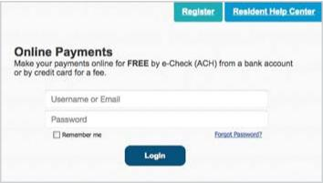

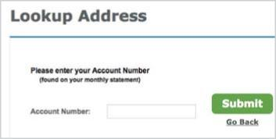




 | Manage & Pay Your Charges & Assessments Online We provide a convenient and secure way for you to manage and make payments online through ClickPay. Get started by following the instructions listed below.
Creating Your Profile
Visit login.clickpav.com/firstservice, click Register, and then create your online profile.
Account Already Exists?
If you receive a message stating that an account already exists, you have already been pre-registered within ClickPay. Click the link within the activation email sent to you or simply request a password reset link to gain access to your existing profile.
Connecting Your Property
Enter the FirstService Residential account number found on your statement or coupon and the Last Name listed on the property agreement.
Last Name Entered Not Working?
Try the co-owner last name or if a business, the full name of the
business associated with your unit.
Direct-Debit Users if you're looking to gain access to your existing automatic ACH Direct-Debit profile transition to ClickPay, you will be required to verify your banking details associated with this payment schedule.
Adding a Payment Option
When setting up one-time or scheduled payments, you will be required to select a new or existing payment option, including e-check (ACH) for FREE or credit and debit card for a nominal fee.
Set Up Scheduled Payments
From the home screen, click Auto Pay and then select your payment option, payment frequency and amount.
Full Amount
Select this option if you want to automatically pay ALL charges on your account, including assessment charges, special assessments, and one-time fees. You may be provided with the option to set a maximum as well.
Fixed Amount
Select this option if you want to pay a fixed amount of the total due. Any amount due above the fixed amount will not be paid automatically and you will need to submit a separate, one-time payment for any overage.
Please ensure your payments are scheduled to run no more than 2-3 days before your payment being due as your balance may not be available to pull through ClickPay until on or after this date.
Need Additional Help? Visitwww.ClickPay.com/GetHelp or call 1.888.354.0135 (option 1).
Welcome to Rancho Vistoso
https://ranchovistosohoa.com/
12

Slide 13

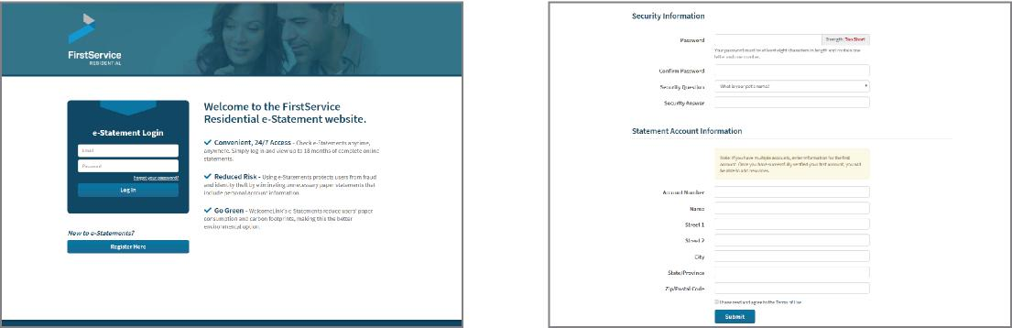
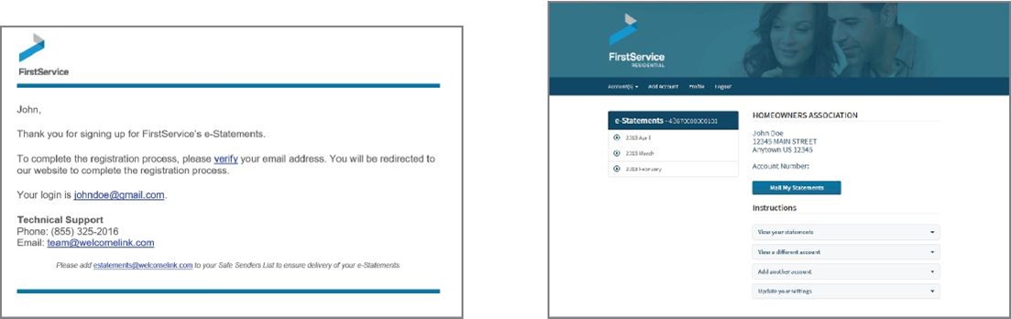
eStatement Quick Reference Guide
We have made registering for eStatements quick and easy.
Just follow four simple steps!
1 Create Your eStatement Account 2 Set Up Password and Security Question
Go to: https://estatements.welcomelink.com/Arizona. You will be required to set up a password as well. Click "Register Here." Enter the basic account and answer a security question. The security question information from your most recent statement. It will be used to reset your password if you forget it
3 Verify Your Email Address 4 View Your Statements
After finishing the account setup, a verification email
will be sent to the email address provided.
You must click the link in the email to finish
the verification process and receive
electronic statements.
To view your statements, click the month and year that correlates to the statement you’d like to view. You may then download the statement to a PDF format.
Welcome to Rancho Vistoso
https://ranchovistosohoa.com/
13

Slide 14
Convenient, Secure eStatement from
FirstService Residential
FirstService Residential is happy to announce that you can
now receive your monthly maintenance bill electronically!
FirstService Residential's new eStatement program is:
Convenient. Check eStatements anytime, anywhere. Simply log in and view up to 12 months of complete online statements.
Secure. Choosing eStatements protects users from potential fraud and identity theft by eliminating unnecessary paper statement mailings that include personal account information.
Green. eStatements reduce paper consumption and carbon footprints, making them the better environmental option.
Register now at: https://secure.welcomelink.com/estatements/mg/rg
Welcome to Rancho Vistoso
https://ranchovistosohoa.com/
14

Slide 15

Q: What happens if my email address changes or is discontinued for any reason?
A: If your email address changes or is discontinued, you will need to log in to the website and update your account information. Click on "My Account" and update your email address. A verification email will be sent to your new email account and eStatement delivery will continue normally.
Q: What if I have multiple accounts?
A: You may register all your accounts with one login. Make sure to have all of your account information
available when you register, then click "Add Additional Account" until all accounts are set up.
Q: What if I forget my login password?
A: Visit the eStatements website and click on "Forgot Your Password?" A password reminder will be sent to your email account.
Q: Is the website secure?
A: The eStatement website uses modern encryption technology and is VeriSign Trusted. For more information about encryption security, please visit https://trustsealinfo.verisign.com.
Q: Who do I contact if I have questions?
A: If you have questions regarding your account or the contents of your statement, call FirstService
Residential’s Customer Care Center at (855)333.5149. For technical support with the website or
creating your login, call (866) 428-0800 or email team@welcomelink.com.
eStatements Frequently Asked Questions
Q:
A:
Q:
A:
Q:
A:
Q:
A:
Welcome to Rancho Vistoso
https://ranchovistosohoa.com/
15

Slide 16
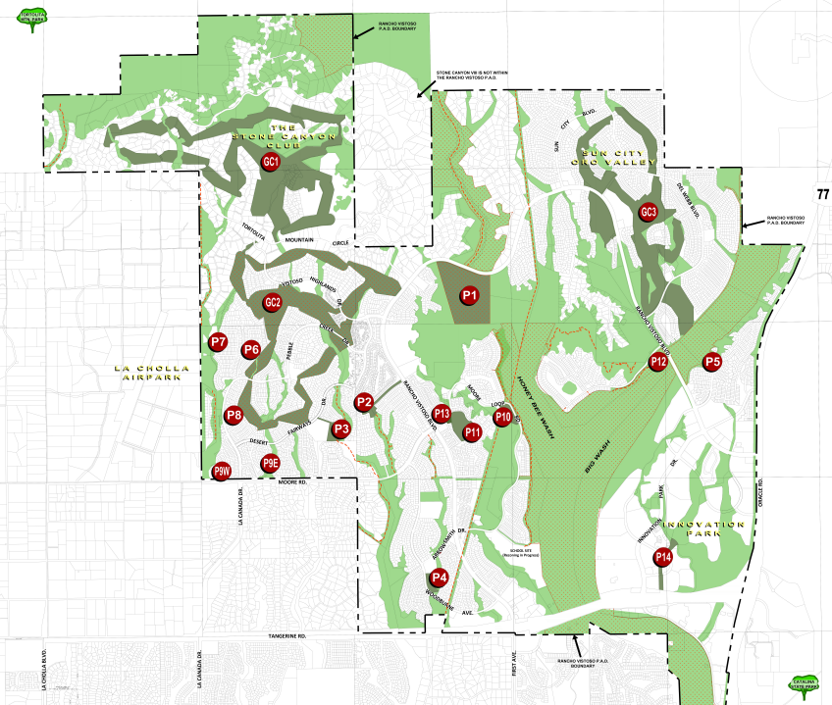
VCA Park and Trail Map
To view all VCA Maps including a more detailed trail map please visit:
https://ranchovistosohoa.com/community/rancho-vistoso-maps/
Welcome to Rancho Vistoso
https://ranchovistosohoa.com/
Welcome to Rancho Vistoso
https://ranchovistosohoa.com/
16

Slide 17
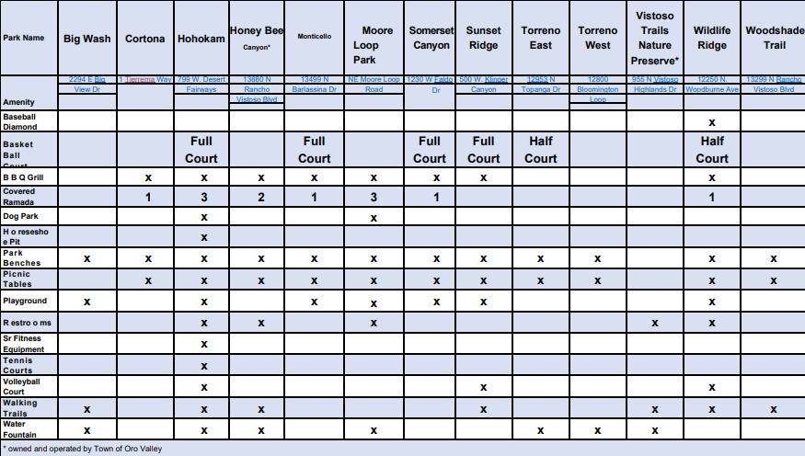
VCA Park and Trail Amenity Table
To view all park and trail info, including a more detailed amenity table please visit:
https://ranchovistosohoa.com/community/rec-areas/
Welcome to Rancho Vistoso
https://ranchovistosohoa.com/
Welcome to Rancho Vistoso
https://ranchovistosohoa.com/
17

Slide 18


Communications
4-5
E-NEWSLETTER
Vistoso Community Association
Your community newsletter is your go-to place for all updates in your community. This will include upcoming events, announcements, developer updates, contests, and more. If you are not receiving the monthly community e-newsletter, please visit: https://ranchovistosohoa.com/resident-information/email-and-newsletter-sign-up/ to register today.
WEBSITE
Register at https://ranchovistosohoa.com/
This will be your central hub to review Governing Documents, access your community calendar, important forms
and more.
Welcome to Rancho Vistoso
https://ranchovistosohoa.com/
17

Slide 19
h
Compliance Reminders
We encourage you to take the time to become familiar with the association’s Rules and Regulations, which can be found at https://ranchovistosohoa.com/resident-information/governing-documents/
PARKING – The Covenants, Conditions, and Restrictions (CCRs) regulate parking within the community. All the parking-related restrictions are available for review in the CCRs.
All residential properties within Rancho Vistoso have onsite parking facilities, including garages and the driveway in front of the garage.
Vehicles parked in the driveway shall not encroach on sidewalks or landscaped/hardscaped areas.
Overnight street parking is not allowed.
Parking of abandoned or inoperable vehicles is prohibited on any residential lot outside private garages.
Overnight parking in parks or common areas is prohibited.
RV’S/TRAILERS/RECREATIONAL VEHICLES – Parking motor homes, trailers, boats, and recreational vehicles within the community, outside garages is allowed only for loading and unloading within a maximum time frame of 48 hours. Please contact our office before parking motor homes, trailers, boats, and recreational vehicles.
HOLIDAY DÉCOR – Holiday decorations can be installed 30 days prior to the recognized holiday and must be removed 20 days after the holiday associated with the decorations.
LIGHTING – All exterior lighting must provide for complete shielding of the bulbs, lamps, and the source of the light from view. One should see the effect of the light, not the lamp itself. Lights shall not be directed onto neighboring properties and the Common Areas. Lights strung on plants or patios, poles, eaves, etc., are prohibited except during recognized holidays.
TRASH CANS – Please place trash containers on the curb on the designated trash pickup date and time unless stipulated by your Sub-Association (if applicable). Owners must place containers so they are not visible from neighboring properties, streets, or common areas except for a reasonable time immediately before and after collection. Please contact management if cans will be out for an extended time.
FLAGS– The Vistoso Community Association follows proper flag etiquette outlined in the State of Arizona, A.R.S. §§ 33-1261, section A. and Federal Flag Code (P.L. 94-344;90 Stat.810; 4 United States Code §§ 4-10). Please reference this section for approved flags or contact management staff at askVCA@ranchovistosohoa.com or (520) 354-2729 with questions regarding flags, flagpoles, windsocks, and banners. Flags shall not exceed 4’x6’.
Welcome to Rancho Vistoso
https://ranchovistosohoa.com/
18

Slide 20

Architectural & Landscaping Review
The Architectural & Landscaping Guidelines protect your property values and preserve the character of the community. A comprehensive guide to modifying the exterior of your home while remaining in compliance with the established community guidelines is required. To view the most recent edition of the Guidelines please visit:
https://ranchovistosohoa.com/resident-information/helpful-documents/
There are three main steps to completing a proper Architectural Application.
Complete an application that corresponds with your neighborhood. More information on what to include in your application can be found at:
https://ranchovistosohoa.com/resident-information/forms/
Complete a site plan for the project. Site plans must be legible and must include dimensions, materials, colors & any other details that may be helpful. Submit the application, site plan, and any additional supporting documentation of the project to at: askVCA@ranchovistosohoa.com.
Please allow up to 30 days for review and processing. Notifications regarding your project including approval letters, will be sent through Smartwebs, our architectural review software. Once you received approval from the Architectural & Landscape Review Committee, you may schedule or begin your project.
4-5
Welcome to Rancho Vistoso
https://ranchovistosohoa.com/
19

Slide 21
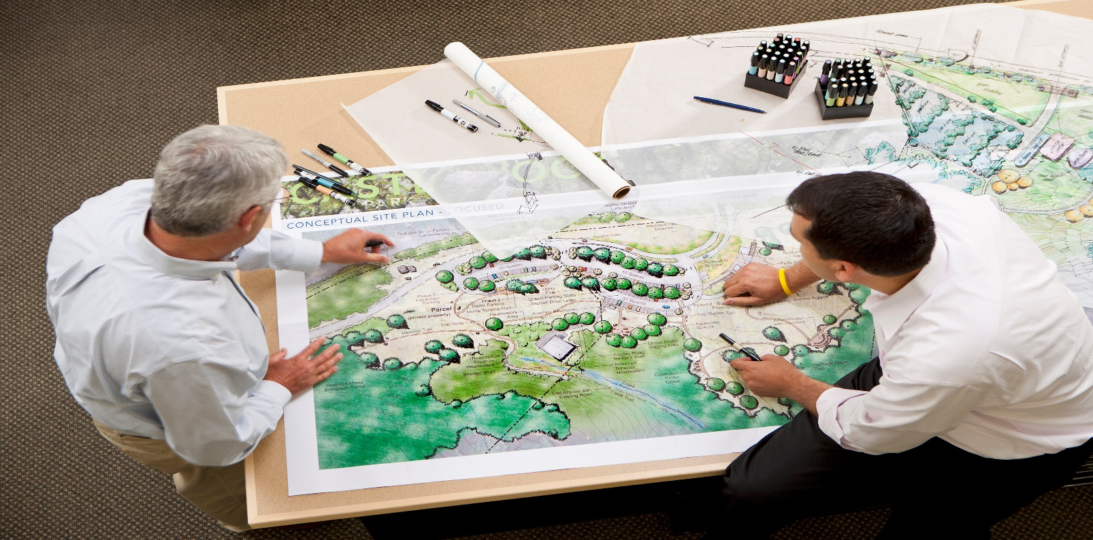

Helpful Tips
Identify the sizes and distance from trees, patio covers, and structures to the side and rear property lines (setback).
Choose plants and trees from the suggested plant list and include plant species in your plans.
Please make sure to include your email address for the fastest updates regarding your request.
Please include photos of materials you plan to use.
If you live in a sub-association, please submit your request to your sub-association first. The sub-association must review and approve a request before the VCA master association can review the request.
Any fixed exterior modification request requires advanced approval. This includes adding or removing plants, updating pavers or the hardscape, and any changes to the home’s exterior.
Please allow up to 30 days for review and processing.
All updates shall be emailed through the VCA’s architectural review software, Smartwebs. Please make sure to search Smartwebs in your email platform and mark Smartwebs as a “safe” or “known” contact.
4-5
Welcome to Rancho Vistoso
https://ranchovistosohoa.com/
20

Slide 22

FAQ
How can I pay my assessment dues?
You can send a check, set up recurring monthly payments with your bank, or sign up with ClickPay for automatic payments. Please reference page 11 for payment options.
What is an HOA?
As a property owner, you’re automatically a part of the association. The Board of Directors is elected to serve as advocates for the members, establish operating policies and standards, and support community interests.
What do my assessments pay for?
How can I find out about community events?
Please visit: https://ranchovistosohoa.com/community/community-news/
Monthly assessments support the community operations and reserve funds. To view budgets and reserve studies please visit https://ranchovistosohoa.com/resident-information/reserve-studies/ .
How often are the communities inspected?
What if my questions aren’t included on this list?
We are always happy to hear from you and answer any questions you may have. Please feel free to call or email us.
Each neighborhood is thoroughly inspected once a month, but the staff is out in the community multiply time throughout the week.
Welcome to Rancho Vistoso
https://ranchovistosohoa.com/
21

Slide 23


https://ranchovistosohoa.com/
1171 E Rancho Vistoso Blvd, Suite 103, Oro Valley, AZ 85755| (520) 354-2729
22

